Slide 1

Dialogflow CX- Competition
Conversational-Flow
By- Abhirup Bhattacharya

Slide 2

Agent Name –
Nicholas
This Bot is a kind of programming Assistant.

Slide 3
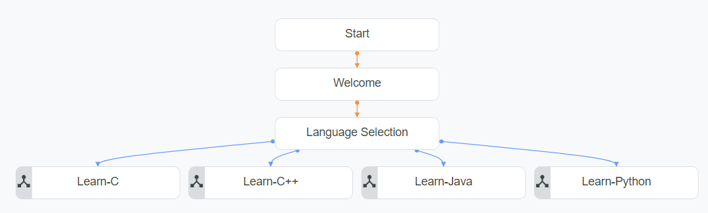
DEFAULT STRAT FLOW
Start By writing – Hi/hello etc.

Slide 4
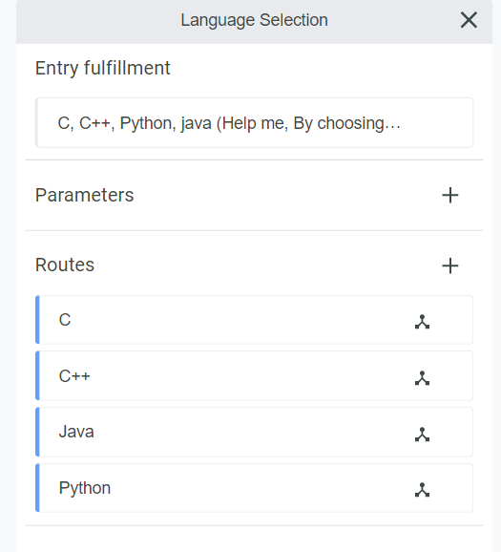
Language Selection
LOADING

Slide 5
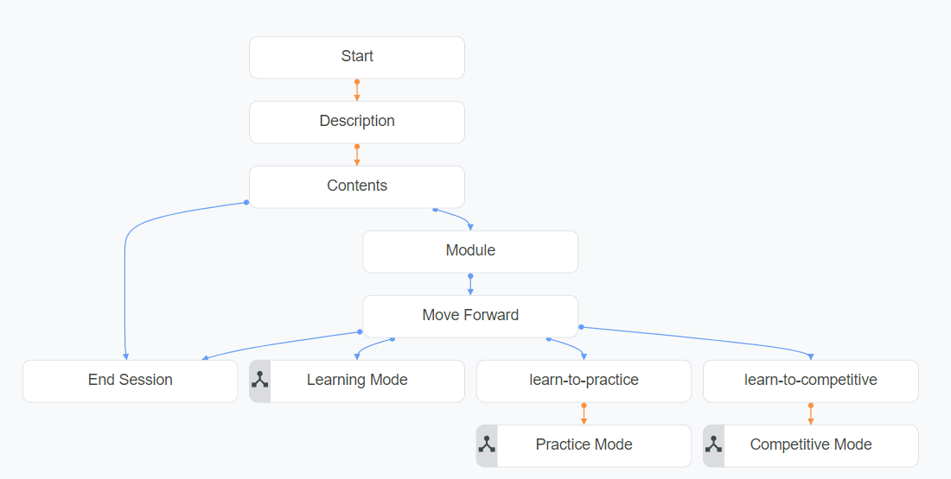
Learn-C

Slide 6
Learn-C
End Session
Learning Mode
Competitive Mode
Practice Mode

Slide 7
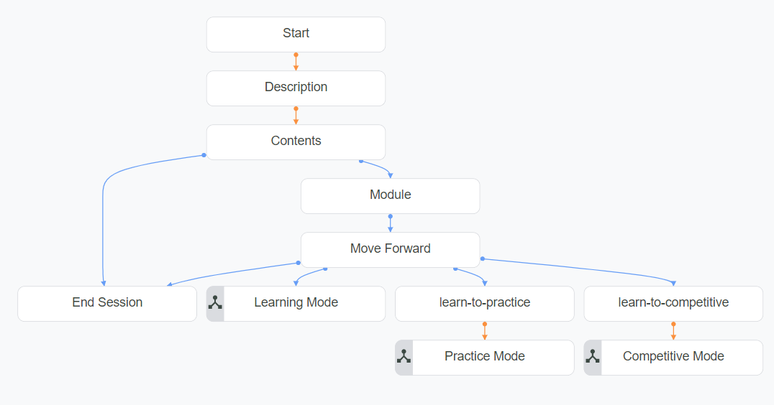
Learn-C++

Slide 8
Learn-C++
End Session
Learning Mode
Competitive Mode
Practice Mode

Slide 9
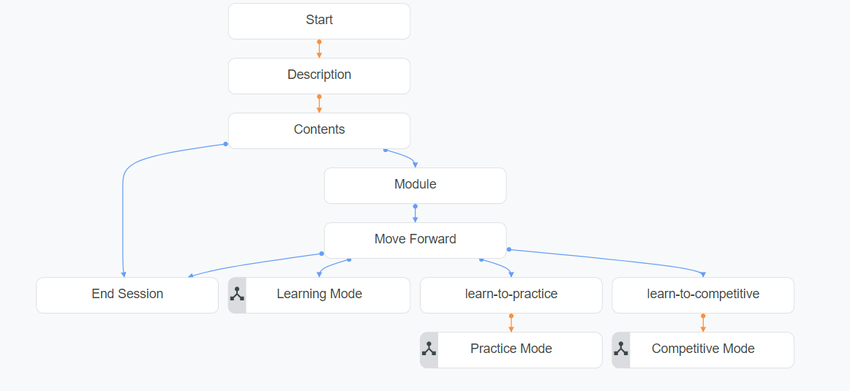
Learn-Java

Slide 10
Learn-Java
End Session
Learning Mode
Competitive Mode
Practice Mode

Slide 11
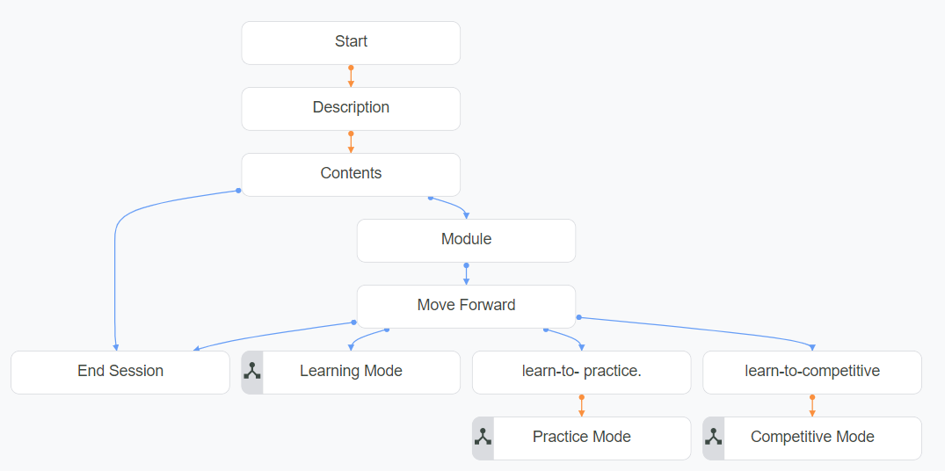
Learn-Python

Slide 12
Learn-Python
End Session
Learning Mode
Competitive Mode
Practice Mode

Slide 13
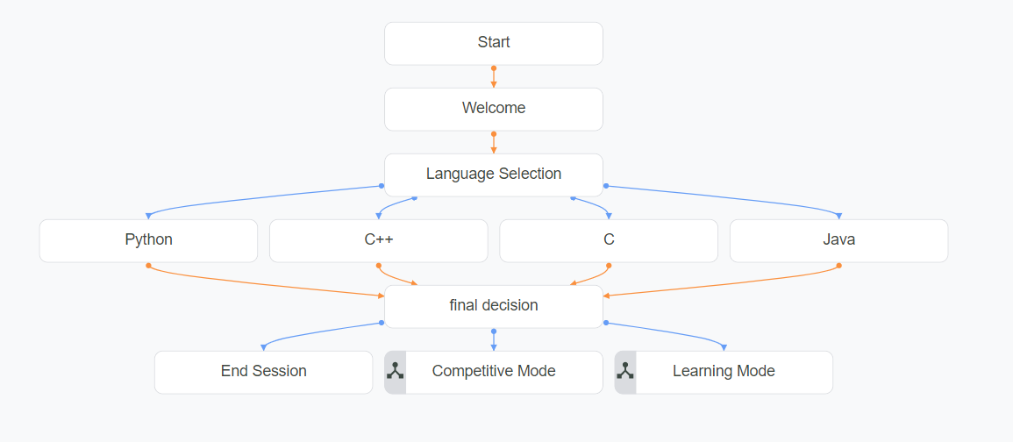
Practice Mode

Slide 14
Final Decision
End Session
Learning Mode
Competitive Mode

Slide 15
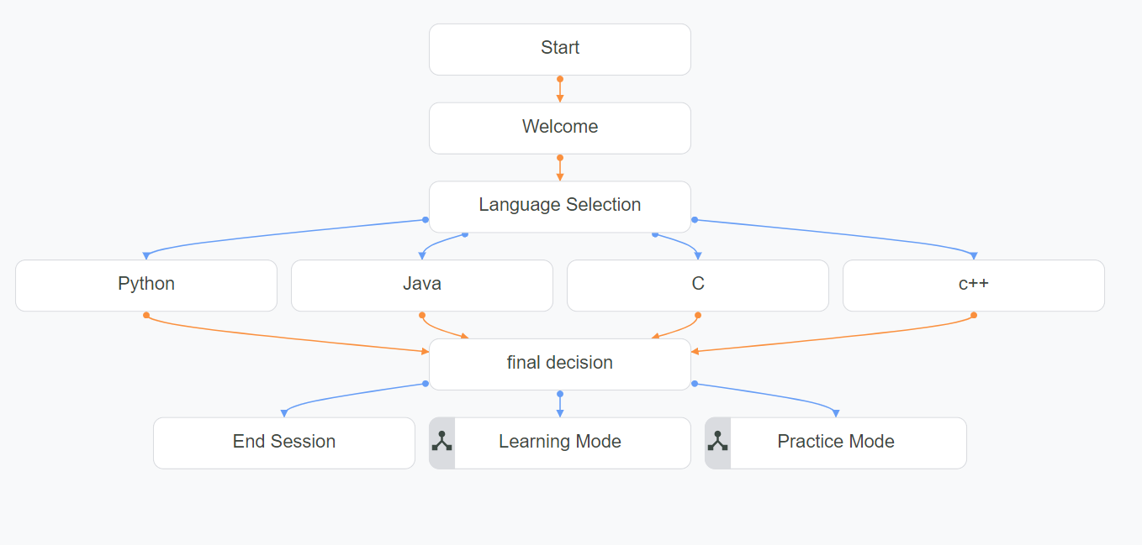
Competitive Mode

Slide 16
Final Decision
End Session
Learning Mode
Practice Mode

Slide 17
THANK YOU

